Slide 1
Risk Management Meeting
ACS (M)
August 2018
Notes:
1

Slide 2
PERSONAL FINANCING
Notes:
2

Slide 3
PERSONAL FINANCING BUSINESS - RMM
Agenda:
Product Level KRIs
PF Product Share
Customer Income Band by FA Composition
Market Receivables
Competitors Campaign Activities
Notes:
3

Slide 4
Summary of KRI (June – August 2018)
KRI | Threshold |  |  | June’18 | July’18 | August’18
 | Satisfactory | Alert | Critical
NPL Ratio | < 2.06% | 2.06% - 2.56% | > 2.56% | 2.07% | 1.93% | 1.82%
NCC Ratio | < 4.02% | 4.02% - 6.20% | > 6.20% | 3.62% | 4.01% | 3.74%
Effective Interest Rate | > 18.25% | 15.26% - 18.25% | < 15.26% | 18.16% | 18.20% | 18.29%
Note :
August 2018 NPL Ratio reduced by 0.11% MOM at satisfactory range.
August 2018 NCC Ratio reduced by 0.27% MOM at satisfactory range.
August 2018 EIR (%) had improved by 0.09% vs. July 2018. Average income increased MOM by 1.3% @ RM 4.063Mil

Slide 5
Product Level KRIs (NPL ratio %)
Data %
Satisfactory | Alert | Critical
< 2.06% | 2.06% - 2.56% | > 2.56%
August 2018 NPL ratio is at Satisfactory range 1.82%. MOM reduce by 0.11% (July 2018: 1.93%)

Slide 6
Product Level KRIs (NCC ratio %)
Data %
Satisfactory | Alert | Critical
< 4.02% | 4.02 – 6.20 | > 6.20%
August 2018 NCC ratio is within satisfactory range at 3.74%. MOM reduced by 0.27%. (August’18 NCC: RM 4.3mil)

Slide 7
Product Level KRIs (Effective Interest Rate % )
Data %
Satisfactory | Alert | Critical
> 18.25% | 15.26% - 18.25% | < 15.26%
August 2018 EIR% is within Satisfactory at 18.29%. MOM EIR increased by 0.09%.

Slide 8
S&P by Product Share % (Normal, Express, Low Interest, Refinancing)
Count (%)
S&P Count ’Avg | Normal | Express | Low Interest | Refinancing | Total
June’18 | 2,735 | 2,650 | 563 | 1,125 | 7,073
July’18 | 3,713 | 3,140 | 677 | 2,203 | 9,733
August’18 | 3,998 | 3,355 | 747 | 3,173 | 11,273
New Customers had increased MOM by 7.7% in August 2018. Total Customers in August’18 increase by 15.8% Vs. July’18

Slide 9
Customer Income Band by FA (S&P) Composition (Q3FYE18 – August 2018)
S&P Count %
Inc.Band
MOM | June’18 |  |  |  | July’18 |  |  |  | August’18
FA | <18K | 18-24K | 24-36K | >36K | <18K | 18-24K | 24-36K | >36K | <18K | 18-24K | 24-36K | >36K
<5K | 74 | 76 | 204 | 152 | 157 | 126 | 309 | 172 | 161 | 119 | 286 | 184
5-10K | 289 | 310 | 658 | 561 | 555 | 459 | 875 | 628 | 543 | 495 | 942 | 778
10-15K | 416 | 516 | 906 | 806 | 564 | 769 | 1,274 | 1,116 | 634 | 843 | 1,352 | 1,172
15-20K | 5 | 14 | 201 | 212 | 3 | 12 | 588 | 558 | 1 | 8 | 745 | 719
>20K | 8 | 19 | 582 | 1,063 | 3 | 4 | 458 | 1,103 | 0 | 6 | 721 | 1,564
FA band >20K in August’18 increase by 46.1% MOM. Total on FA band >20K in August’18 : 2,291 Vs. July’18 : 1,568

Slide 10
Profitability Measurement (August’17 – August’18)
Profitability (%)
FYE2018 | Aug'17 | Sept’17 | Oct’17 | Nov’17 | Dec’17 | Jan'18 | Feb’18 | Mar’18 | Apr’18 | May’18 | Jun’18 | July‘18 | Aug‘18
Actual Profitability | 41.7% | 41.0% | 35.3% | 39.0% | 38.5% | 36.3% | 40.0% | 48.6% | 42.3% | 50.7% | 35.0% | 34.8% | 43.8%
Budgeted Profitability | 52.4% | 36.3% | 52.7% | 52.9% | 53.9% | 54.7% | 54.5% | 50.5% | 53.8% | 52.0% | 54.4% | 50.8% | 53.8%
Profitability (%) = Profit Before Support Cost / Revenue

Slide 11
Risk Management : Market Receivables
(Unit :RM' Million)
NO. | BANK | Q1FYE19 | Q2FYE19 | Q2 vs.Q1 (%) | NO. | BANK | Q1FYE19 | Q2FYE19 | Q2 vs.Q1 (%)
1 | MBSB | 20,313 | 20,041 | 98.7% | 9 | ACSM | 1,960 (May) | 2,095 (Aug) | 106.9%
2 | CIMB | 13,071 | 13,291 | 101.7% | 10 | OCBC Bank | 1,522 | 1,381 | 90.7%
3 | Bank Islam | 12,725 | 13,079 | 102.8% | 11 | Standard Chartered | 976 | 979 | 100.3%
4 | Public Bank | 6,784 | 6,858 | 101.1% | 12 | Affin Bank | 713 | 703 | 98.6%
5 | RHB Bank | 6,225 | 6,536 | 105.0% | 13 | Bank Muamalat | 619 | 671 | 108.4%
6 | Maybank | 6,303 | 6,396 | 101.5% | 14 | Citibank | 368 | 452 | 122.8%
7 | Hong Leong Bank | 2,207 | 2,170 | 98.3% | 15 | Al-Rajhi | 581 | - | N/A
8 | Alliance Bank | 1,939 | 2,103 | 108.5%
N/A : Not Available

Slide 12
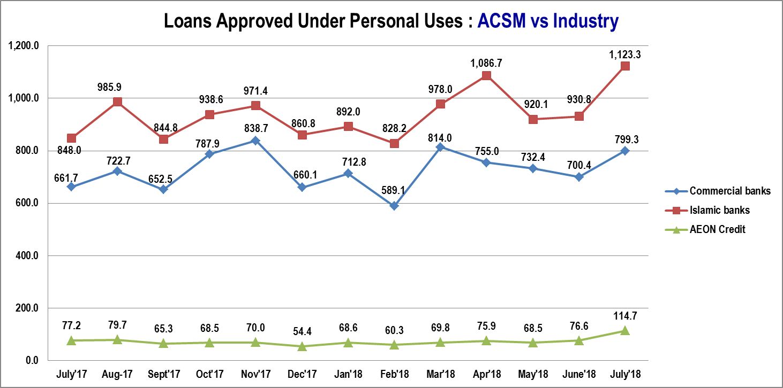
Personal Financing Industry Comparison
(Source: BNM Statistic)

Slide 13


Personal Financing (Risk Category: Market Risk: New & existing campaign)
Campaign | AEON i-CASH | Features
ACS Web Campaign |  | 1) Apply ACS Online Campaign Eligibility : Open to All New Application submit via Online channel. Application & S&P Date : 6st Aug – 30th Sept 2018, Sign S&P 15th Oct 2018. Rewards : Eligible customers will be rewarded 2 months 0% profit rate as Cash back based on Approved Loan amount. Fulfillment : Apply 6th – 31st Aug 2018, fulfillment period Oct 2018. Apply 1st – 30th Sept , fulfillment period By Nov 2018.
 | AEON i-CASH | Features
ACS Campaign |  | 2) AEON i-Cash Special Promotion Rate (Permanent Feature) Eligibility : Open to New and Existing customer who submitted with complete supporting documents via All channels. FA Amount : RM1,000 – RM100,000 Rewards : Special Profit Rate as low as 0.66% per month for Monthly income > RM2,000. For income <RM2,000 Profit Rate is 1.2% - 1.5% per month. Profit rate is subject to assessment.

Slide 14


Personal Financing (Risk Category: Market Risk: New & existing campaign)
Campaign | Citibank Personal Loan | Features
Citibank Campaign |  | Eligibility Malaysian citizens or PF Aged between 21 to 60 years old Earn an annual income of RM48,000p.a. FA : RM5K- RM150K. Eligible amount up to 10times of monthly income. Interest Rate : 5.88% p.a. – 9.88% p.a. Tenure : 24 – 60 months No Processing Fee.
 | Hong Leong Personal Loan
Hong Leong Campaign |  | Eligibility Open to Malaysian citizens Aged between 21 to 60 years old Earn an annual income of RM24,000 p.a. Campaign Duration : Apply on 7th July 2018 – 31st Oct 2018. Disburse by 30 Nov 2018. FA : RM20K- RM250K. Interest Rate : 8% p.a. Tenure 2- 5 years Submission Gift : First 150 customers for each month will be rewarded a Digital Camera. Total 450 units. Prompt payment customer will be eligible for Rebate of 25% of total interest paid after the 7th Instalment and on subsequent month.

Slide 15

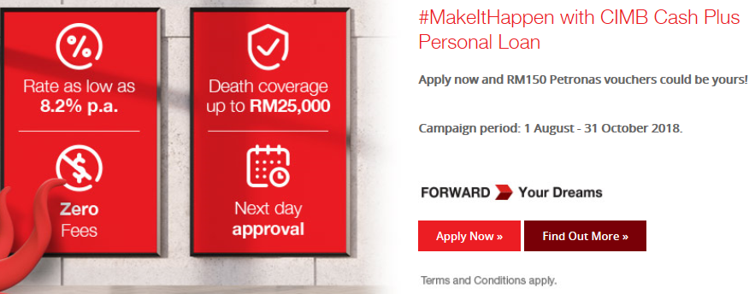
Personal Financing (Risk Category: Market Risk: New & existing campaign)
Campaign | UOB Personal Loan | Features
UOB Campaign |  | Eligibility : Open to New and Existing Customer of UOBM. Malaysian Citizen or PR, Age between 21- 55 years Minimum Gross Income : RM2,000 Interest Rate based on Income : RM2K < RM4K (Salaried), RM3K < RM6K (Self Employed) :11.99% p.a. RM4K < RM7K (Salaried), RM6K < RM8K (Self Employed) :10.99% p.a. RM7K < (Salaried), RM8K < (Self Employed) :9.99% p.a. Feature / Rewards : Eligible to receive 25% interest rebate on total interest payable, subject to monthly instalment is paid on or before the due date during the entire tenure. Campaign Duration :1st Apr – 30th Sept2018. Disburse by 31st Oct.
 | Cash Plus Personal Loan | Features
CIMB Campaign |  | Eligibility : Malaysian Citizen, Age 21- 58 yrs. Min Income RM2,000, In employment more than 6 months. For Self Employed; Business to be more than 24 months. Features : 8.2%p.a., 1 day Approval, Zero fees, death coverage RM25K Campaign Period : 1 Aug – 31 Oct 2018. Application Channel : Apply via CIMB Website with complete document submitted. Min FA : RM10,000 – RM100,000 Up to 5 years tenure. Rewards : RM150 Petronas Voucher

Slide 16

Personal Financing (Risk Category : Market Risk: New Product Features )
Product Feature | RHB Personal Financing /-i | Features
RHB Personal Financing |  | Eligibility : For Private Sector, Civil Servants & Pensioners FA : RM2K - RM200K Profit Rates as low as : Other Benefits : On-the-spot approval and disbursement Repayment as low as RM57.54 Tenure up to 7 years (Pensioner max tenure 10 years) Debt Consolidation
Pvt Sector | 8.18% p.a.
Civil Servant | 4.5% p.a.
Pensioners | 5.25% p.a.

Slide 17





Personal Financing Campaign Market Comparison
Bank / FI | Campaign Name | Features | Duration | Rewards
 | Ringgit plus promotions | Apply via Ringgitplus, FA: RM2K –RM200K. Tenure 2 - 10 years | 13th Dec 2017 - 31st Dec 2018 | RM50 Giant Voucher
 | Ringgit plus promotions | Apply via Ringgitplus, Approved & disbursed FA > 20K | 06th June’17 - 30th Sept 2018 | RM100 Touch ’n Go Card
 | Ringgit plus promotions | Apply via Ringgitplus, Approved & disbursed FA : RM1K – RM100K | 18th June 2018 - 18th June 2019 | Aeon Gift Voucher RM50
 | Ringgit plus promotions | Apply via Ringgitplus, FA: RM5K-RM250K. Tenure up to 10 years | 6th Sept – 5th Oct 2018 | 1 Oppo Smartphone + 1 simcard + 1 powerbank
 | Ringgit plus promotions | Apply via Ringgitplus, FA: RM500 -RM50K. Tenure 1 - 5 years | 10th Aug 2017 – 31st Dec 2018 | RM30 AEON Voucher

Slide 18




Personal Financing Campaign Market Comparison
Bank / FI | Ringgit Plus | Features | Duration | Rewards
 | Ringgit plus promotions | Apply via Ringgitplus, FA:RM5K- RM150K.Tenure 1 - 7yrs | 20th July – 31st Sept 2018 | RM50 Petrol Voucher
 | Ringgit plus promotions | Apply via Ringgitplus, FA:RM21K- RM150K Tenure 1 - 5yrs | 6th Sept - 5th Oct 2018 | 1 Oppo Smartphone + 1 simcard + 1 powerbank + 1 year iFlix
 | Ringgit plus promotions | Apply via Ringgitplus, FA:RM5K- RM150K. Tenure 2 - 5yrs | 6th Sept – 5th Oct 2018 | 1 Oppo Smartphone + 1 simcard + 1 powerbank + 1 year iFlix
 | Ringgit plus promotions | Apply via Ringgitplus, FA:RM3K- RM250K. Tenure 1 - 5yrs | 31st July – 30th Sept 2018 | RM50 Giant Gift Card

Slide 19


Personal Financing (Risk Category: Market Risk: New & existing campaign)
Campaign | Kuwait Finance | Features
Ringgitplus rewards |  | Eligibility : Open to all customers apply online via Ringgit plus website and are subsequently approved and disbursed. FA : RM5,000 – RM250,000. Profit rate as low as 6% p.a. Tenure : 2 - 10 years. Campaign Durations : Application on 6th Sept – 5th Oct 2018, Approved and Successfully disbursed by 31st Jan 2019. Rewards: 1 Oppo smartphone A71K, 1GetFi simcard, 1 Ringgitplus Powerbank
 | JCL
 |  | Eligibility : Open to all customers apply online via Ringgit plus website and are subsequently approved and disbursed by JCL . FA : RM500 – RM 50,000. Tenure : 1 - 5 years. Campaign Durations : 10 Aug 2017 – 31st Dec 2018. Approved by JCL by 1st Mar 2019. Rewards: RM30 AEON Voucher

Slide 20


Personal Financing (Risk Category: Market Risk: New & existing campaign)
Campaign | Easy by RHB - Easy Pinjaman Ekspres | Features
Ringgitplus rewards |  | Eligibility: Open to all customers who applied via Ringgit plus website and submit the application at any RHB Easy Branch during the campaign period, and are then subsequently approved and disbursed. FA : RM21K – RM150K Campaign Durations: 6th Sept - 5th Oct 2018. Rewards : 1 Oppo smartphone A71K, 1GetFi simcard, 1 Ringgitplus Powerbank + 1 year iflix subscription.
 | Citibank
Ringgitplus rewards |  | Eligibility: Apply Personal Loan via at Ringgitplus website and subsequently approved and disbursed. FA : RM5K- RM150K. Tenure : 2 - 5 years, Min Annual Income : 48K. Campaign Durations: Application on 6th Sept – 5th Oct 2018, Approved by 30th Nov 2018. Rewards : 1 Oppo smartphone A71K, 1GetFi simcard, 1 Ringgitplus Powerbank + 1 year iflix subscription.

Slide 21
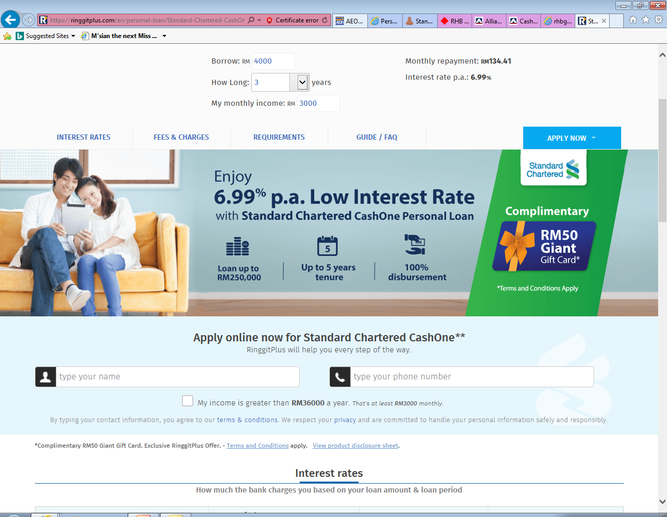

Personal Financing (Risk Category: Market Risk: New & existing campaign)
Campaign | Standard Chartered | Features
Ringgitplus rewards |  | Eligibility : Open to New to bank customers. Apply for SC CashOne via online Ringgitplus website and Successfully disbursed. FA : 3K - 250K, Tenure : 1- 5 years. Campaign Durations: 31st July – 30th Sept 2018. Rewards: RM 50 Giant Gift Card
 | UKHWAH Cash-i
 |  | Eligibility : Apply online via Ringgit plus website and subsequently approved and disbursed by Ukhwah. Open to Government Personal or GLC who salary is deducted from Angkasa. FA : RM2,000 – RM 200,000 Tenure : 2 - 10 years. Campaign Durations : 13th Dec 2017 - 31st Dec 2018. Rewards: RM50 Giant Voucher

Slide 22


Personal Financing (Risk Category: Market Risk: New & existing campaign)
Campaign | HSBC Amanah Personal Financing – I | Features
Ringgitplus rewards |  | Eligibility: Open to customers who apply via Ringgit plus website and are subsequently approved and receive financing for more than RM20,000. New Customer : Minimum income 5K. Existing Customer : Minimum income 3K. FA RM20,000 and above. Tenure up to 7 years to entitle for (profit rate) 8.75% p.a. Campaign Durations: 06th June’17 – 30th Sept 2018. Rewards : FA > 20K Approved & Disbursed : RM100 Touch ‘n Go Card.
 | AEON i-CASH
 |  | Eligibility: Open to New and Existing customers who apply via Ringgitplus website and are subsequently approved and disbursed. Application Channel : Will be route to ACSM Telemarketing Team HQ. FA : RM1,000 – RM100,000 Campaign Durations : 18th June 2018 -18th June 2019 Rewards :AEON Gift Voucher worth RM50

Slide 23

Personal Financing (Risk Category: Market Risk: New & existing campaign)
Campaign | Alliance Bank | Features
Ringgitplus rewards |  | Eligibility: Open to all customers who applied via Ringgitplus website and subsequently approved and disbursed. Min income : RM 3K monthly. FA : RM5,000 - RM150,000. Tenure : 12- 84 Months. Profit rate : As low as 3.99%p.a. Campaign Durations: Application on 20th July – 31st Sept 2018. Rewards: RM50 Petrol Voucher

Slide 24
Thank
You

Slide 25



Personal Financing (Risk Category : Market Risk)
Items
Product Name | Cash First Personal Loan Cash Vantage Financing-i | Personal Financing-i | Personal Financing -i
Finance Amount | RM5,000 – RM150,000 | RM5,000 – RM250,000(6 to 9x salary) | Package Personal Financing: RM10,000 – RM200,000 Non-package Personal Financing: RM 10,000 – RM150,000
Interest Rate | 8.38% p.a. for RM5,000 For 7 years tenure | 9% - 13.5% p.a. | Non Package Personal Financing-I : 6% to 7%p.a. with takaful. 7% to 8% p.a. without takaful. On-package Personal Financing-I : 4.99% p.a.
Tenure | 12 – 84 months | 24 – 84 months | 12 - 120 months
TAT | 24 hours | 48 hours | Fast approval
Min. Salary | RM3,000 | RM2,000 | Package Personal Financing: RM2,000 Non-package Personal Financing: RM 3,500
Min Installment | RM 94 | RM103 | RM883.30
LPC. | 1% p.a. on overdue amount | 1% p.a. on the amount in arrears | 1% p.a. on overdue installment until date of full payment
Processing Fee | NIL | NIL | NIL
Disbursement | IBG/IBFT | IBG - 3 working days | -
Docs Required | MyKad, Disbursement Account particulars, 1 or 3 months pay slip or Latest 6 months EPF Statement or Form BE / EA. | Mykad, 3 months pay slip, 2 months EPF , B/BE Form & 6 months personal bank statement | MyKad & 3 months pay slip, Latest employers confirmation letter, or latest 3 months Bank Statements of salary crediting account, latest tax income form or EPF statement.

Slide 26



Personal Financing (Risk Category : Market Risk)
Items
Product Name | Maybank Islamic Personal Financing | Easy-Pinjaman Express | Quick Cash Edge
Finance Amount | RM5,000 – RM100,000 | RM2,000 – RM150,000 | RM4000 - RM250,000
Interest Rate | 11% p.a. : RM5,000 - RM20,000 10% p.a. : RM20,001 - RM 50,000 9% p.a. : RM50,001 – RM 100,000 | 8.18%p.a. – 13.38%p.a. | 6.996% p.a.
Tenure | 1 - 6 years | 12 – 84 months | 12 – 84 months
TAT | Fast Approval | 10mins | Fast approval
Min Salary | RM 2,500 | RM1,500 | RM 2,000
Min Installment | RM115.28 | RM57.54 | -
LPC. | 1% p.a. on the amount in arrears | 1% of overdue amount | 1% of overdue amount
Processing Fee | N/A | N/A | N/A
Disbursement | - | 10mins after approval | 1day after approval
Docs Required | MyKad, Latest 2 months salary slips and Latest 6 months Account Statement or Latest BE form with official tax receipt and Business Registration | MyKad , Salary Slip, EPF Statement & Bank Statement | MyKad, 1month pay slip & Bank Statement, EPF statement or BE form

Slide 27


Personal Financing (Risk Category : Market Risk)
Items
Product Name | Personal Financing-i | Personal Loan - AmMoneyLine | Maybank Personal Loan
Finance Amount | RM4,000 - RM250,000 | RM2,000 – RM100,000 | RM5,000 – RM100,000
Interest Rate | Fixed profit rate at 6.99% p.a. | 8.0% p.a. to 11.99% p.a. | 8% p.a. : RM5K - RM20K 7% p.a. : RM20K - RM50K 6.5% p.a. : RM50K - RM100K
Tenure | 12 - 60 months | 12 – 60 months | 24 - 72 months
TAT | 14 days | 48 hours | 10mins
Min Salary | RM1,000 | RM2,000 | RM2,500
Min Installment | - | RM104 | RM102.78
LPC | 1% p.a. of overdue installment | 1% p.a. of overdue installment | 1% p.a. of overdue amount
Processing Fee | NIL | NIL | NIL
Disbursement | - | - | 10mins after approval
Docs Required | MyKad, 3 months pay slip, bank statement & Form J/EA/EC | MyKad, 3 months pay slip & 3 months bank statements or latest EPF statement | MyKad, latest BE form with official tax receipt, 3 months pay slip, & 6 months bank statement

Slide 28


Personal Financing (Risk Category : Market Risk)
Items
Product Name | Xpress Cash Financing-i | Cash Plus Personal Loan | Personal Financing-i
Finance Amount | RM3,000 – RM50,000 or 8x gross income | RM2,000 – RM100,000 or 8x gross income | RM5,000 – RM200,000
Interest Rate | 18% - 24% p.a. | Salaried, RM50,000-RM100,000 : 8.2% p.a. Salaried, RM20,000-RM49,900 : 10.88% p.a. Salaried, RM2,000-RM19,900 : 14.66% p.a. Self Employed, RM2,000-RM100,000 :14.66% | 4.3% p.a. : Biro Perkhidmatan Angkasa 6.9% p.a. : Selected private and government-linked companies
Tenure | 6 – 60 months | 12 – 60 months | 24 – 48 months
TAT | 24hrs (via TMK). Web / Branch: 7 days | 24hrs (via TMK). Web / Branch: 7 days | -
Min Salary | RM800 | RM2,000 | RM1,500
Min Installment | RM110 | RM58 | RM 122.08
LPC | 1% of overdue installment | 1% of overdue amount | 1% p.a. of overdue installment
Processing Fee | NIL | NIL | Yes
Disbursement | Fast disbursement | Fast disbursement | N/A
Docs Required | MyKad, 3 months pay slip, Bank Statement & EPF Statement | MyKad, 3 months pay slip, Bank Statement & EPF Statement | MyKad, 1 month pay slip & one copy of Saving Account Passbook or Current Account statement

Slide 29

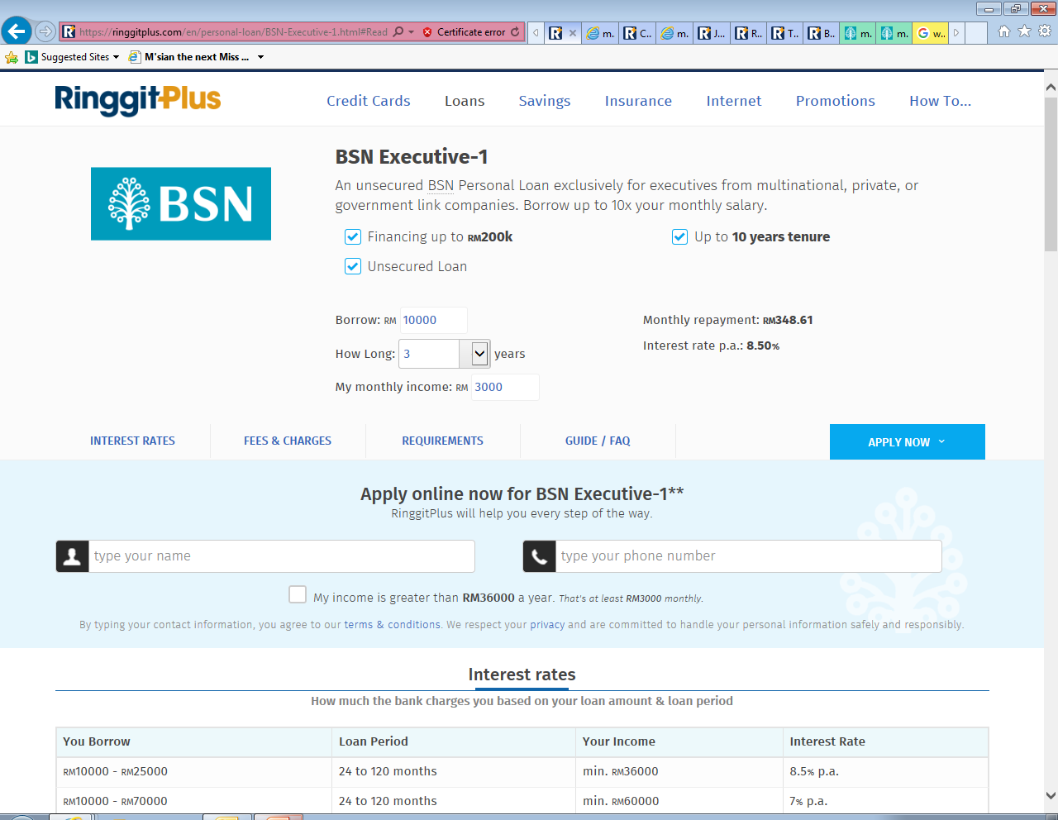

Personal Financing (Risk Category : Market Risk)
Items
Product Name | Personal Financing-i | BSN Executive-1 | Personal Financing-i
Finance Amount | RM5,000 – RM150,000 (up to 5x salary) | RM10,000 – RM200,000 | RM6,000 – RM150,000
Interest Rate | 7.5%p.a. | 6.00% p.a. – 8.50% p.a. | 12.5% p.a. : RM6K – RM19.5K 11.5% p.a. : RM20K – RM49.5K 10.5% p.a. : RM50K – RM150K
Tenure | 12 – 60 months | 2 yrs - 10 yrs | 24 – 84 months
TAT | 48 hours | - | Fast Approval
Min Salary | RM2,000 | RM3,000 | RM3,000
Min Installment | RM90.77 | RM231.25 | RM134
LPC | 1% p.a. of overdue amount | 1% p.a. of overdue installment | -
Processing Fee | Yes | N/A | NIL
Disbursement | CASA Account | N/A | Instant Cash disbursement
Docs Required | 3 months pay slip, BE Form, letter of employment, 6 months EPF & 3 months bank statements | MyKad, 3 months pay slip, latest EPF statement & confirmation letter by employer | MyKad, 3 months pay slip & Form BE

Slide 30

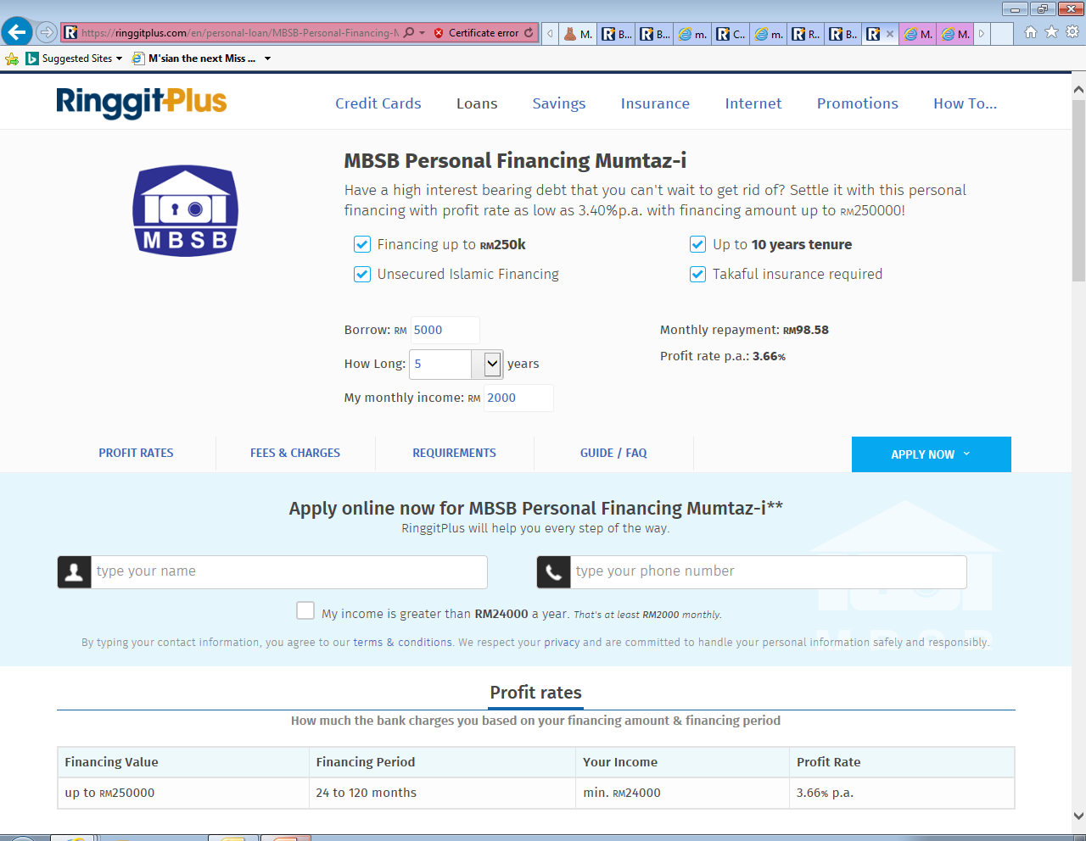
Personal Financing (Risk Category : Market Risk)
Items
Product Name | Personal Financing-i Private Sector | MBSB Personal Financing Mumtaz-i | MBSB Personal Financing Afdhal-i | MBSB Personal Financing-i Private Sector
Finance Amount | RM5,000 – RM150,000(up to 25x monthly gross income) | RM50,000 – RM250,000 | RM50,000 – RM400,000 | RM50,000 - RM300,000
Interest Rate | 4.95% p.a. – 9.37% p.a. | 3.63% p.a. | 4.37% p.a. | 7.43% p.a.
Tenure | 12 – 120 months | 24 – 120 months | 24 – 120 months | 24 -120 months
TAT | - | Fast approval | Fast Approval | Fast Approval
Min Salary | RM 2,000 | RM2,000 | RM15,000 | RM1,000
Min Installment | - | RM569 | RM600 | RM685
LPC. | 1% p.a. of overdue amount | 1% p.a. of overdue installment | 1% p.a. of overdue installment | 1% p.a. of overdue installment
Processing Fee | N/A | Yes | Yes | Yes
Disbursement | CASA Account | N/A | N/A | N/A
Docs Required | Mykad, 3 months pay slip, 3 months bank statements, EPF and Confirm Letter or EA | MyKad, 3 months pay slip, bank account statement | MyKad, 3 months pay slip, bank account statement | MyKad, 3 months pay slip, bank account statement

Slide 31



Personal Financing (Risk Category : Market Risk)
Items
Product Name | AEON i-Cash | I.O.U Personal Loan | Personal Financing-i Public Sector
Financial Amount | RM 1,000 – RM100,000 | RM5,000 – RM250,000 | RM5,000 – RM200,000
Interest Rate | 10.08% - 18% p.a. | 12% p.a. | 3.26% p.a. – 6.53% p.a.
Tenure | 12 – 84 months | 24 – 60 months | 12 – 120 months
TAT | 2-3 days | 1 hour | -
Min Salary | RM 800 | RM2,000 | RM1,000
Min Installment | RM 54 | RM 135 | Floating rate: RM 101 Fixed rate: RM 105
LPC. | 1% p.a. of overdue installment | 1% p.a. of overdue installment | 1% p.a. of overdue installment
Processing Fee | 2% - 4% (Max RM400) | Yes | N/A
Disbursement | IBG / Prepaid Card | CASA Account | CASA Account
Docs Required | 3 months pay slip, EPF & 3 months or 6 months bank statements | 3 months pay slip, BE Form, letter of employment, 6 months EPF & 3 months bank statements | Mykad, 3 months pay slip, 3 months bank statements, EPF and Confirm Letter or EA

Slide 32




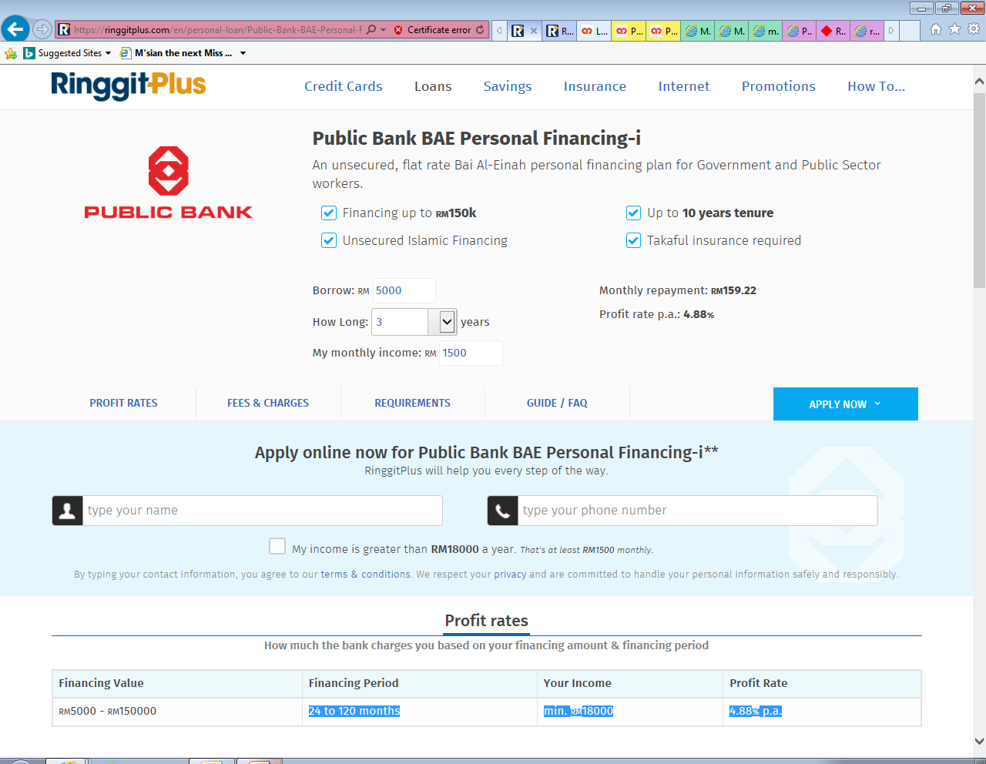
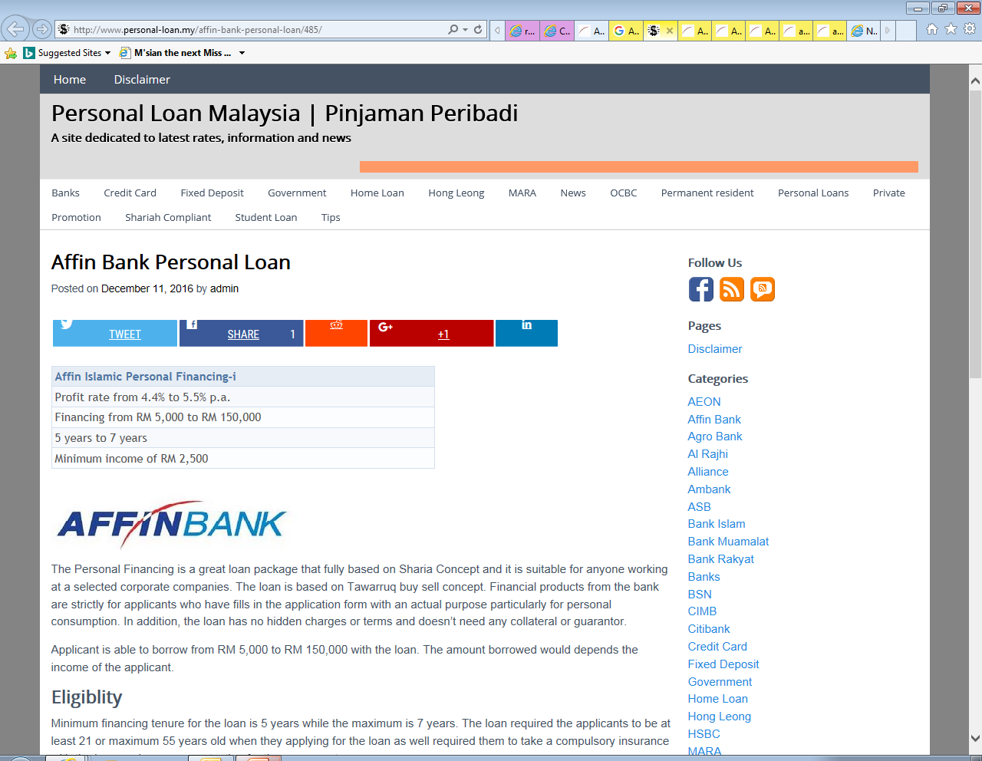
Personal Financing Market Risk
Bank | Product | Interest Rate | Minimum Income | Loan Amount | Max Loan Tenure
 | Citi Bank Personal Loans | 7.9 % p.a. | RM 4,000 | RM5,000 –RM150,000 (up to 8x gross income) | 5 years
 | RHB Personal Finance-i for civil sector | 8.18%p.a. – 15.33% p.a. | RM 2,000 | RM2,000 –RM200,000 | 10 years
 | CashVantage Personal Financing-i | 8.38%p.a. | RM 3,000 | RM5,000 –RM150,000 | 7 years
 | UOB Personal Loan | 9.99%p.a. – 11.99% p.a. | RM 2,000 | RM5,000 – RM100,000 | 5 years
 | Al-Rajhi Personal Financing- i | 6.99% p.a. | RM 5000 | RM5,000 – RM150,000 | 8 years
 | BAE Personal Financing-I (for | 4.88% p.a. | RM 1,500 | RM5,000 – RM150,000 | 10 years
 | Affin Islamic Personal Financing-i | 4.4% p.a. – 5.5 % p.a. | RM2,500 | RM5,000 – RM150,000 | 7 years

Slide 33
Thank
You

